Slide 1

R Training
you ready?

Slide 2
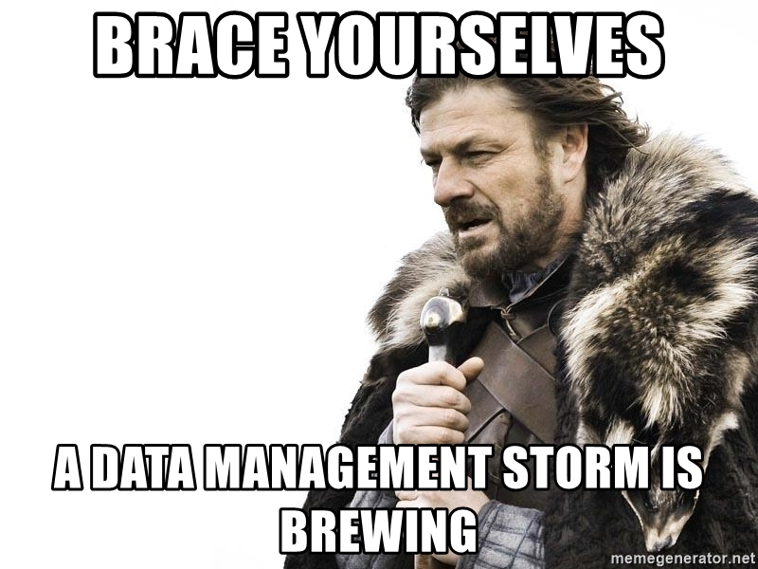
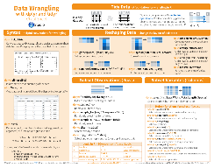
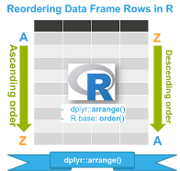
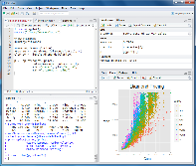

Slide 3
Pre-assessment – skill level

Slide 4
Pre-training assessment: Biggest Fears with learning R?
Doing inaccurate data manipulation
Rusty programming skills
Complex material
Not understanding enough to do independently
Forgetting it quickly

Slide 5
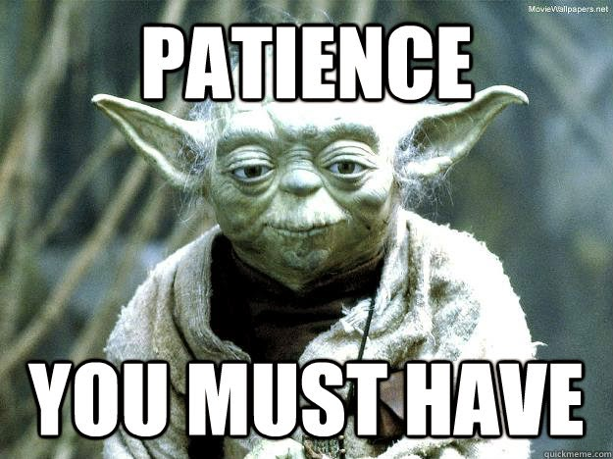
Don’t Worry
We will:
Showcase an easy-to-learn package
Familiarize through exercises
Practice, practice, practice!

Slide 6
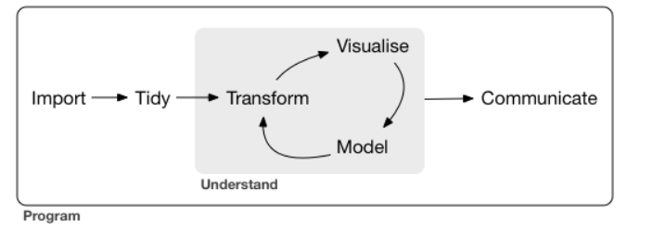
Training Approach
In this training will cover data management principles & data visualization methods in R
Slides ->
Example R script ->
Exercise R script

Slide 7
What is going on with data?
“Every 2 days we create as much information as we did from the dawn of civilization up until 2003” – Eric Schmidt
Mark Zuckerberg noted that billion pieces of content are shared via Facebook’s Open Graph daily – Facebook earnings call, July 2012
“1.5 million more data-savvy managers are needed to take full advantage of big data in the United States” – McKinsey &Co.
A survey reported that more than 37.5% of large organizations said that analyzing big data is their biggest challenge – RainStor, August 2012

Slide 8
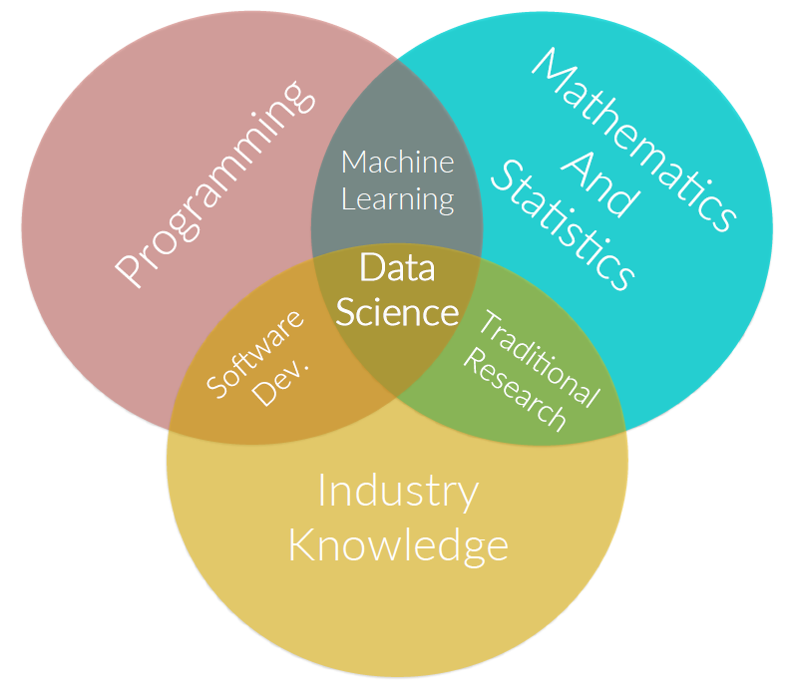
What is data science?
Data science applies the scientific method of analyzing data
It lies at the intersection of several disciplines
It draws on domain specific knowledge that makes the analysis of Big Data possible

Slide 9
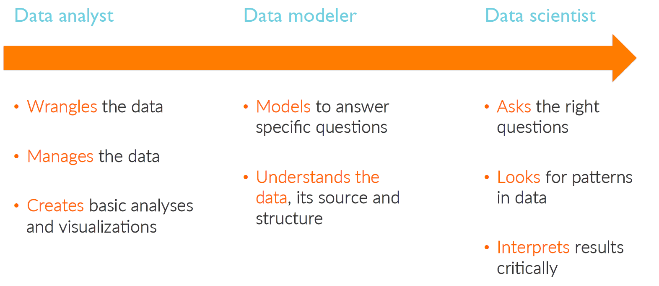
Levels of Expertise

Slide 10
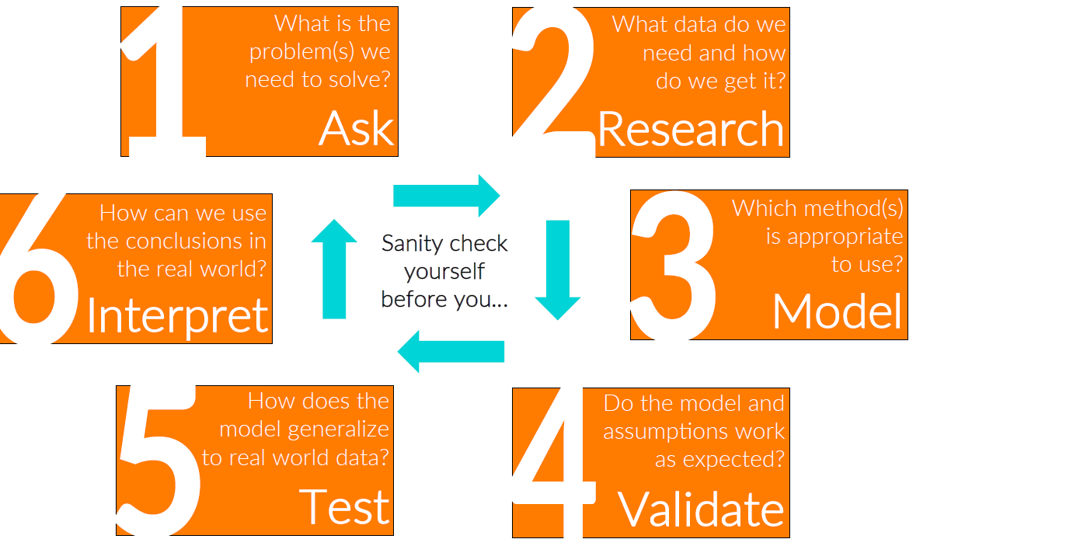
Data Scientist Control Cycle

Slide 11
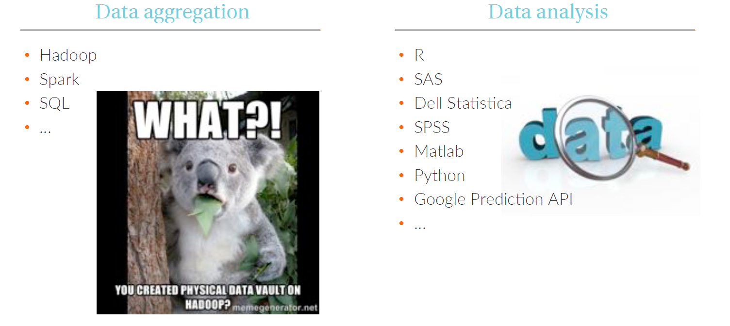
For every job there is a tool

Slide 12
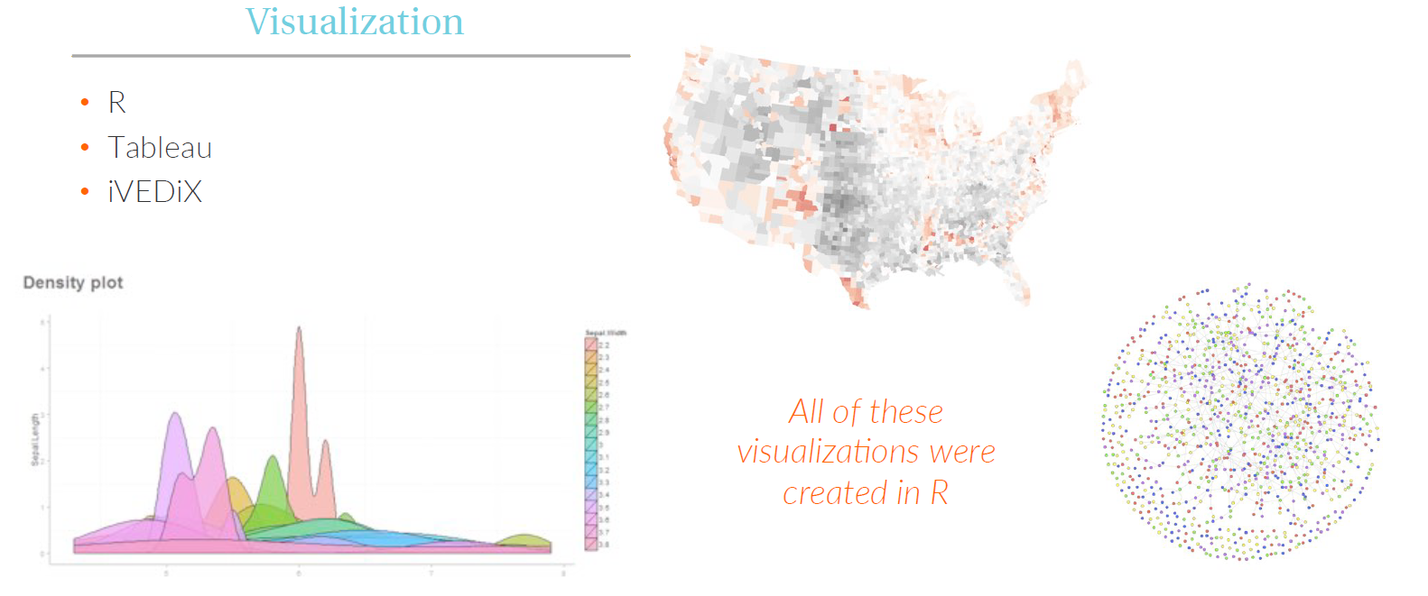
For every job there is a tool

Slide 13
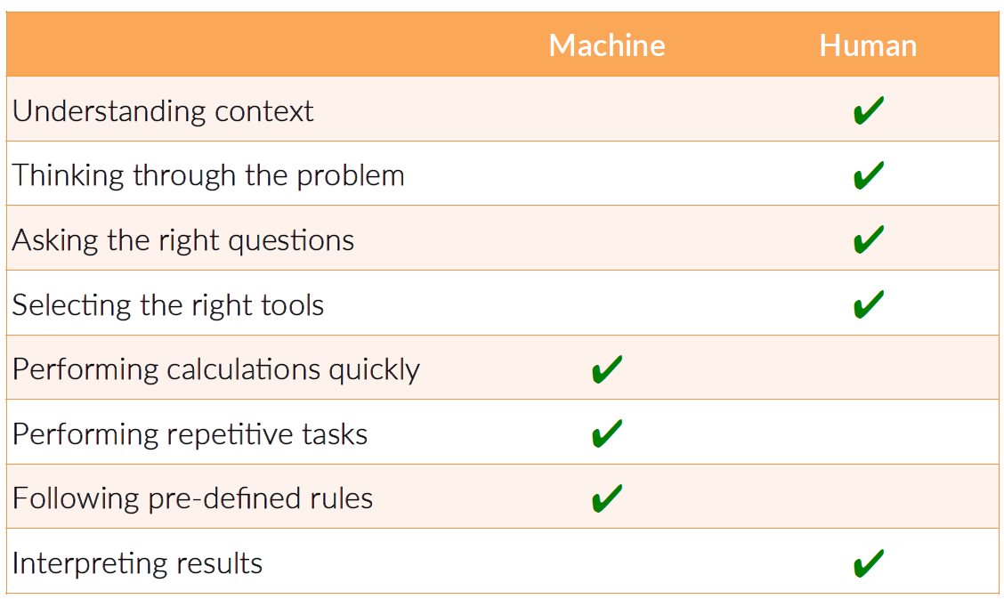
Machine vs human

Slide 14
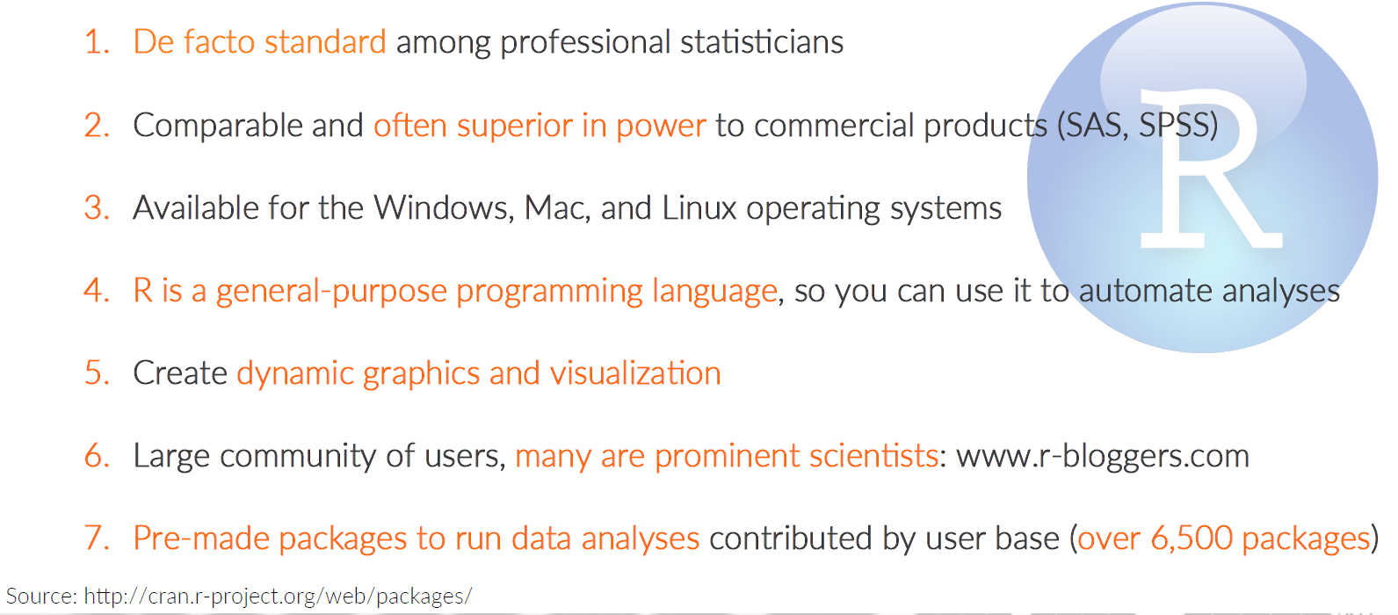
Introduction to R

Slide 15
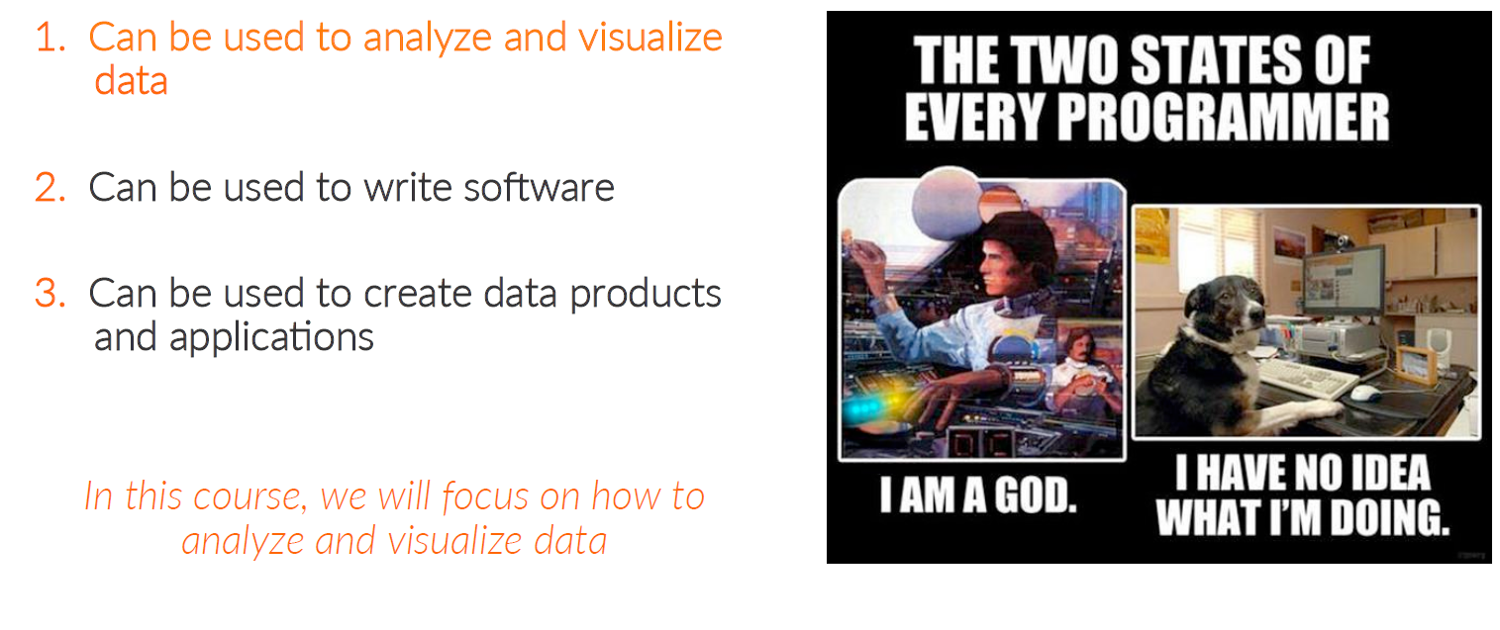
Uses of R

Slide 16
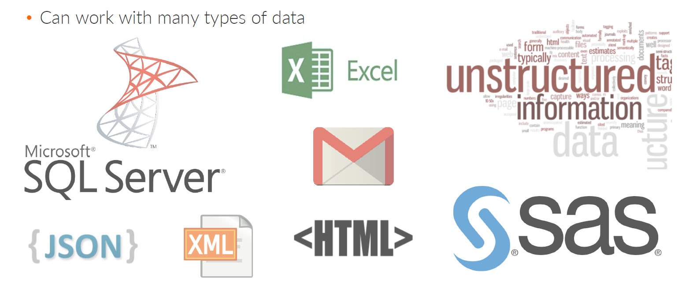
Data Formats R can read

Slide 17
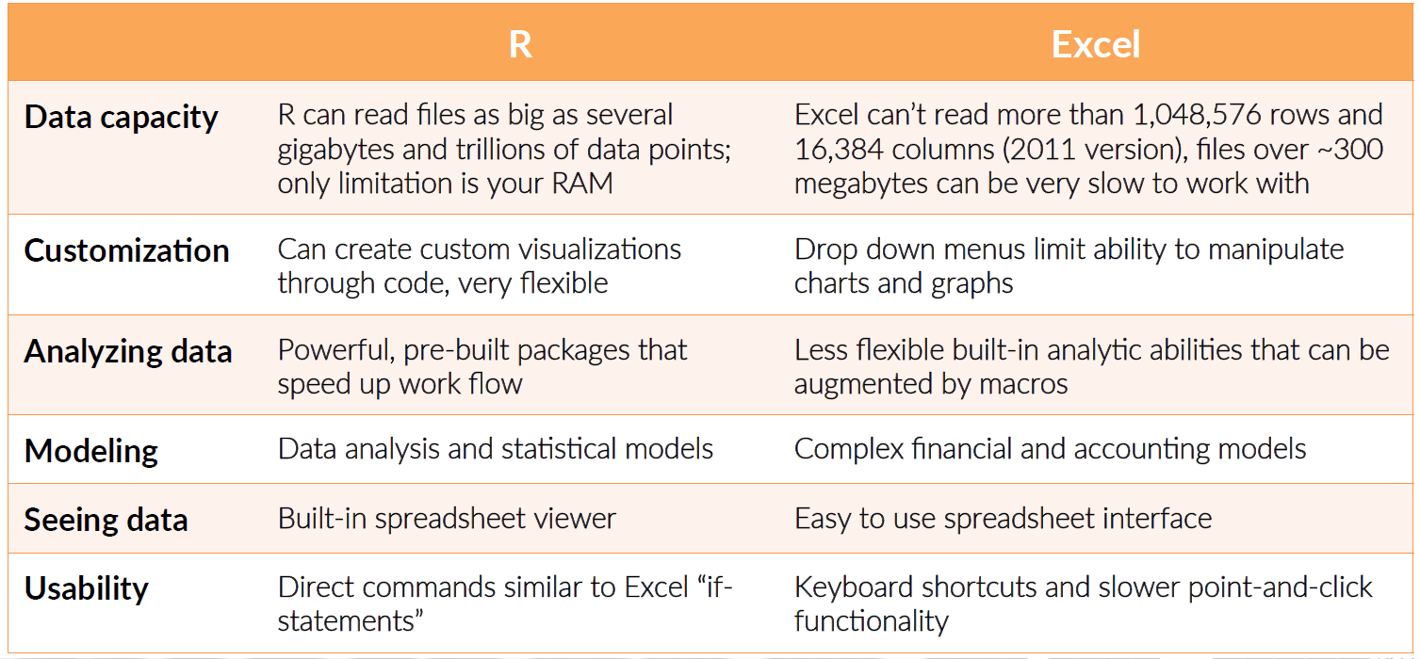
R vs. Excel

Slide 18
Pre-assessment – analytical tools

Slide 19
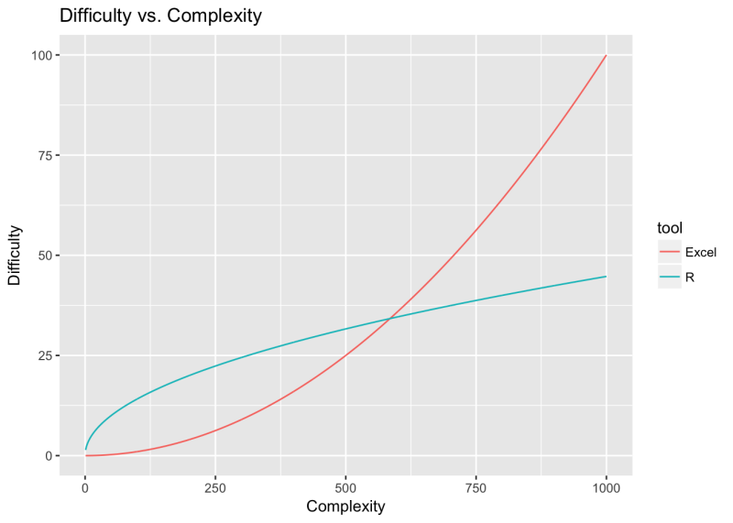
R/RStudio and Excel
http://rex-analytics.com/things-live-r-r-excel-users/
https://www.jessesadler.com/post/excel-vs-r/

Slide 20
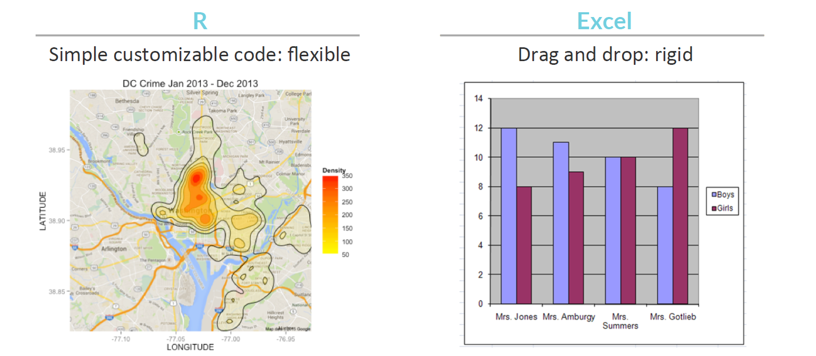
Visualizations in R

Slide 21
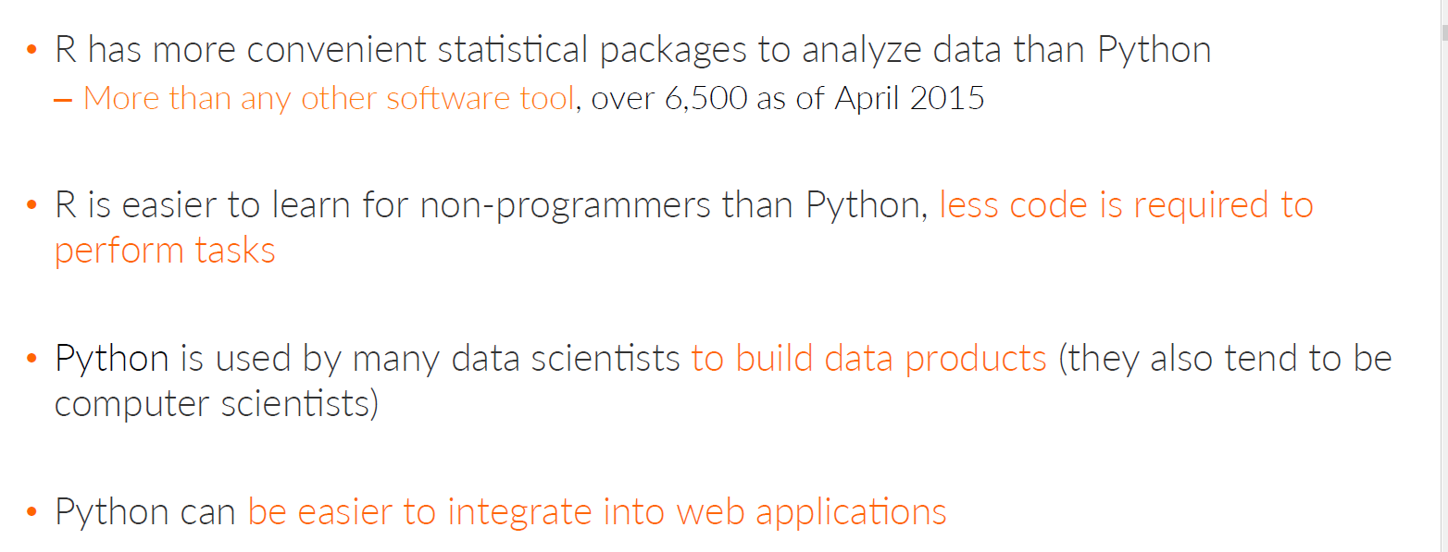
R vs. Python

Slide 22
R we ready?
R is a powerful language and open-source software environment for statistical modeling, data management, and graphics.
R is available for all platforms Windows, Mac, and Unix/Linux.
It is supported by a worldwide repository system, The Comprehensive R Archive Network (CRAN), https://cran.r-project.org/.
Why R? From S plus, by Ross Ihaka and Robert Gentleman at the University of Auckland, New Zealand.

Slide 23
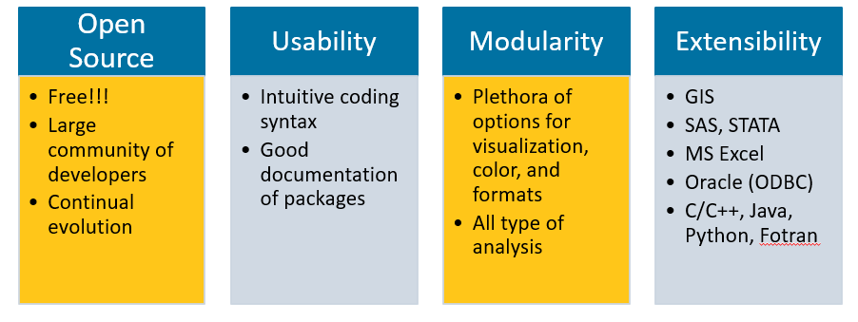
Advantage of R
Developers can write software for R and freely distribute it as add-on packages for R.
CRAN contains thousands of user contributed R add-on packages to supplement the base R distribution, packages such as the sea package that will be used for subnational estimation.

Slide 24
Data Formats R can read

Slide 25
Why do data types matter?
Different functions and commands in R can only work with certain types of data.
You may need to tell R that data from a spreadsheet is either a vector or a list or another type of data before you can perform analysis on it.
Note that a spreadsheet that only includes numbers can be called either a list or a matrix.
You should tell R how to interpret the data based on what analysis you’d like to perform

Slide 26
RStudio
RStudio provides a user-friendly working environment for R.
It is available for Windows, Mac, and Unix/Linux.
R software must be installed first before installing RStudio.
You cannot run RStudio without a current R installation.
RStudio is an integrated development environment (IDE) for R.
It includes many useful features such as
a four-panel layout that includes a console for interactive
R sessions, a source code editor, and panels with
notebooks to organize less central components
tools for plotting
debugging tools
administrative tools for managing packages, the workspace, files, and more.
In short, using RStudio can make using R a lot easier for first time R users.

Slide 27
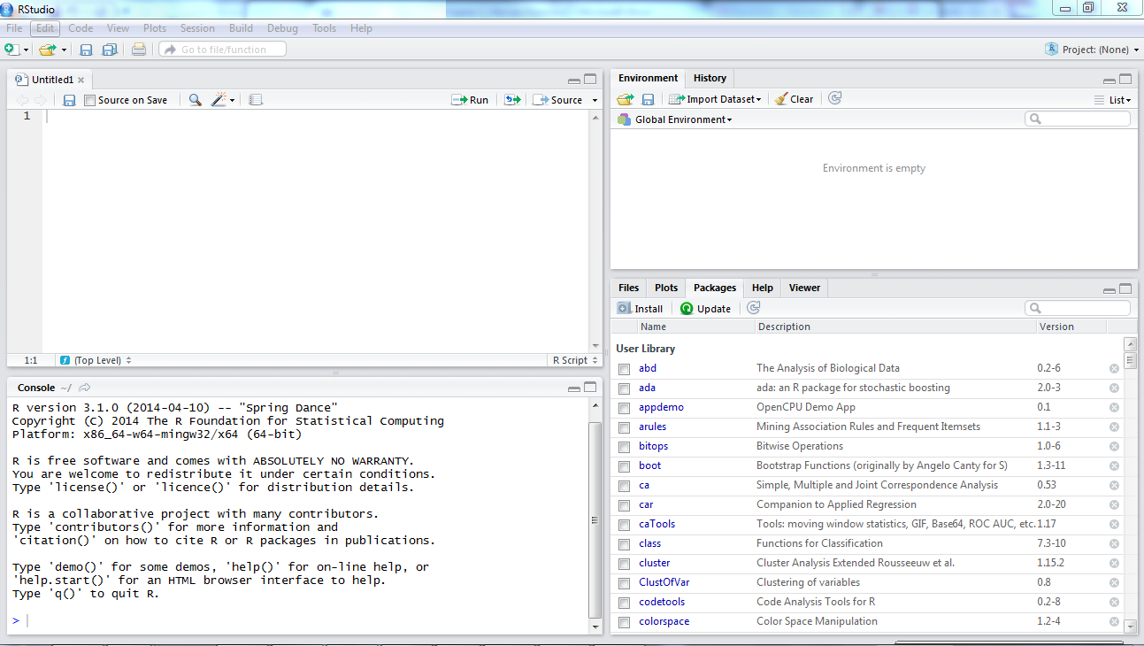
RStudio Interface
Environment stores The workspace tab stores any object, value, function or anything you create during your R session.
R Script file where your record your work
Files tab shows all the files and folders in your default workspace.
Plots tab will show all your graphs.
Packages tab will list a series of packages or add-ons needed to run certain processes.
Console is where you can type commands and see outputs

Slide 28
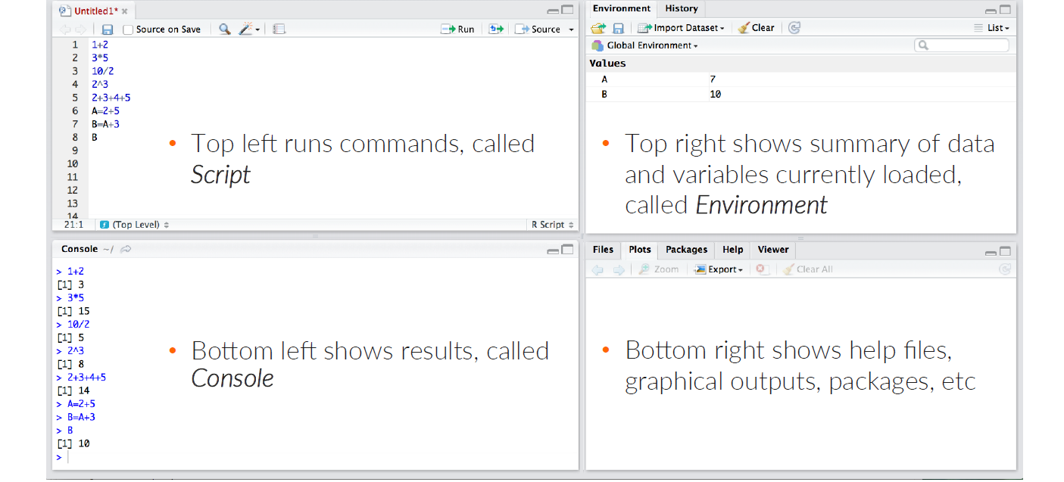
RStudio Interface

Slide 29
Remember
Use help(function name) of ?”function names” to get documentation on a function
R is case-sensitive
Values are assigned to variables in R using ‘<-’ or ‘=‘
Anything entered after # is interpreted as a comment

Slide 30
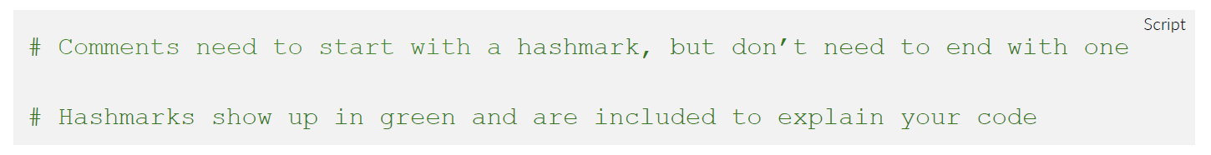
Working with R: Comments
Hashmarks are used to add comments and annotate your code
It is a good practice to annotate your code.
You can go back later and understand what you were doing.

Slide 31
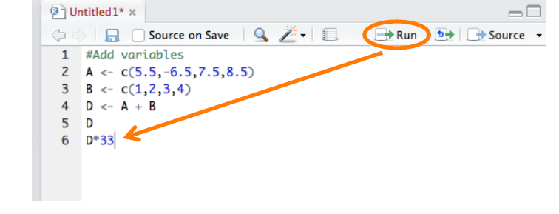
Working with R: Executing
Code is executed when you press “Run” in the top right hand corner of the script window
R runs the line of code where your cursor is located
You can also highlight multiple lines to run at once.

Slide 32
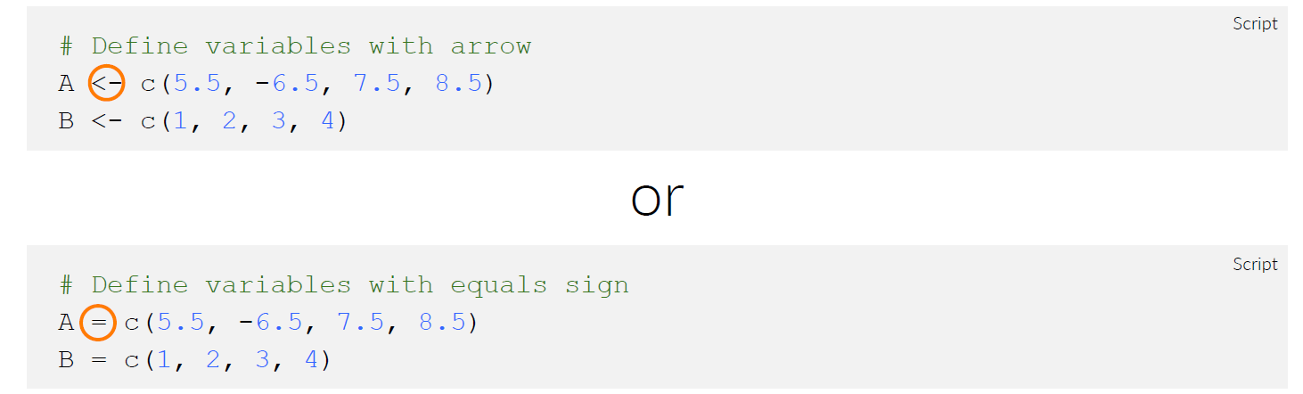
Working with R: variables
A series of numbers (think columns in Excel) can be defined using the arrow (<-) or equals (=) sign
The command c( ) stands for “concatenate” (join) a series of numbers.

Slide 33
Setting up working directory
Working directory in R will read files from a specific location or write files to a specific location
Use function setwd() to set working directory

Slide 34
Ease of analysis
R Keyboard Shortcut
Ctrl+R to run highlighted script in the editor window.
Ctrl+L to clear the console window.
Esc key to terminate a command submitted in R.
Brackets [] are used to extract elements from vectors.
> v<-1:30
> v[5:10]
[1] 5 6 7 8 9 10
Data checks – colnames(), head(), subset()
Descriptives – summary(), table(), aggregate(), dim()
Data manipulation – cbind(), rbind(), new variable (df$new_var), drop rows/ columns

Slide 35
Ridiculous syntax quirks you’ll want to know
Operator | Description
< / > | Less than / greater than
<= / >= | Less than or equal to / greater than or equal to
== | Exactly equal to
!= | Not equal to
!x | Not X
x | y | x or y
x & y | x and y
isTrue(x) | Test if x is true
na.rm = T / F | Remove or keep na values

Slide 36
wRangling Data
Read .csv, .txt, .xlsx files
read.csv, read.delim, read.xlsx, read.table
df <- read.csv(“Users/folder/test.csv", header = TRUE, stringsAsFactors = TRUE, sep =“\t”)
Install packages to read large files faster – data.table, readr
RODBC - Connect to database
library(RODBC) connection <- odbcConnect("<DSN>")
R data structures: scalar, vector and factor, array, data frame, list
Data frames most common – matrix format – each column is a vector
Vector types – character, numeric, factor, integer
Call columns: df[[8]], df[[PSNUuid]], df$PSNUuid, df[,PSNUuid] or df[,8]

Slide 37
aRRgh… do we need to understand R structures
R data structures include:
Vector & factor
Matrix
Data Frame
List

Slide 38
Data Structures
A vector is an ordered collection of numerical, character, complex or logical objects
A factor is a vector for categorical variables
A matrix in R is a one, two, or more dimensional collection of data entries of the same type
All elements of a vector or matrix must be of the same type
I.e. all numeric or all character values
If numeric and character value is entered into an object of type vector or matrix, then R will coerce all elements of the object character type

Slide 39
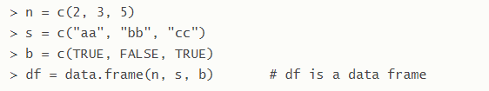
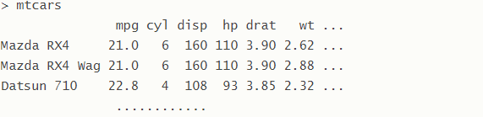
Data Structures
A data frame is a data table that is a list of vectors of equal length. It is used as the fundamental data structure in R. It is the default data type for imported data in R. Data.frame() is the function that creates a data frame.
A list is an ordered collection of objects that can be of different modes
I.e. numeric vector, character vector, matrix, list, etc.

Slide 40
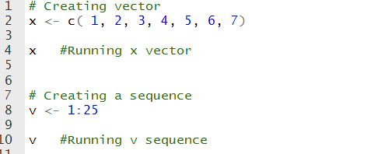
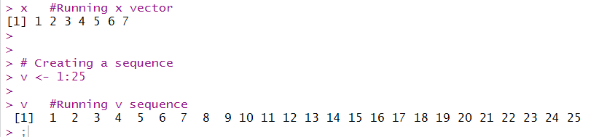
Data Structures: Vector
All elements of a vector must have the same datatype
To create a vector use the c( ) function
To create a sequence use :

Slide 41
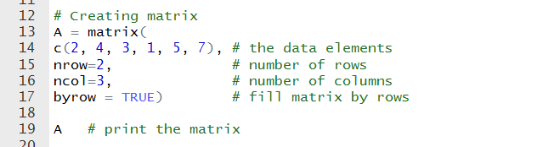
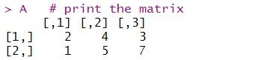
Data Structures: Matrix
A matrix is a collection of data elements arranged in a two-dimensional rectangular layout.
Data elements must be of the same data type

Slide 42
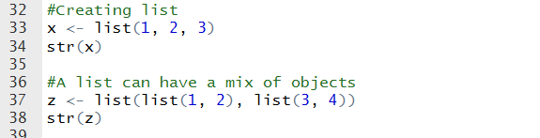
Data structures: List
A list is a generic vector containing other objects
You create a list using list( )
A list can contain a mix of objects

Slide 43
Factors in R
A factor is a unique value in a data set
For example, if fruit types are labeled as “Orange, Apple, Apple, Pear, Banana, Mango, Mango”, the factor would be: “Orange, Apple, Pear, Banana, and Mango”
Use the as.factor() function to tell R to read data as a factor

Slide 44
R Packages
What is a package in R?
R packages are collections of functions and data sets developed by the community.
A package will include code, documentation for the package and for the functions inside, some tests to check everything works as it should, and data sets.
Where do you find R packages?
Install R packages from repositories like CRAN and Github

Slide 45
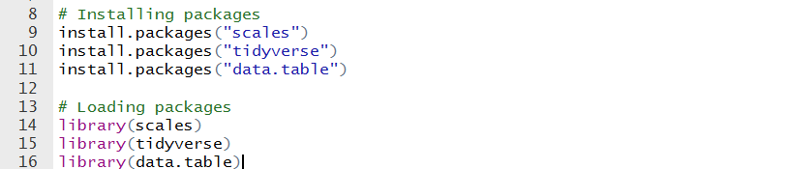
R Packages
Installing R packages
Most common way is to install from CRAN repository
install.package("packagename")
Loading R package
library(packagename)
When you start a current R session will have to load package again

Slide 46
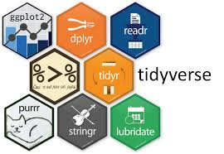
Tidyverse
ggplot2 – creating graphs
dplyr – provides a consistent set of verbs for data manipulation
tidyr – tidying up your data (every variable foes in column and every column is a variable)
readr – reads in data like csv, tsv,
purr – a complete and consistent set of tools for working with functions and vectors. Once you master the basic concepts, purrr allows you to replace many for loops with code that is easier to write and more expressive.
tibble – Tibbles are data.frames that are lazy and surly: they do less and complain more forcing you to confront problems earlier, typically leading to cleaner, more expressive code

Slide 47
YouR Turn
Please install the Tidyverse package in your R session

Slide 48
Data Manipulation using dplyr
dplyr package is one of the core packages in tidyverse
dplyr- Used for data manipulation. Also known as grammar of data manipulation. Most of the data munging processes and methods gets done easily using this package.
Importing data
mydata <- read_csv(“mydataset.csv”)
mydata <- read_tsv(“mydataset.tsv”)

Slide 49
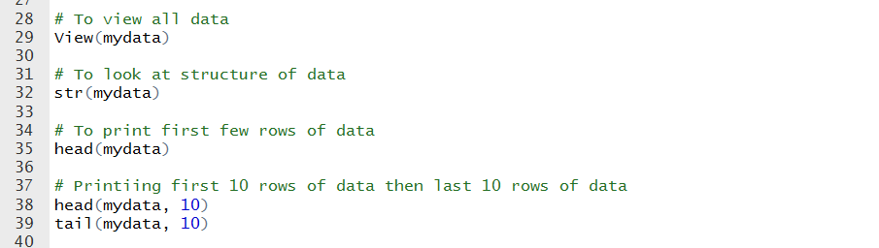
Data Manipulation using dplyr
Get an idea of the data we will be working on by looking at its structure and printing the first few rows of the data.
View( ) *case sensitive
str( )
head( )
tail( )

Slide 50
Data Manipulation using dplyr
mutate() adds new variables that are functions of existing variables
select() picks variables based on their names.
filter() picks cases based on their values.
summarise() reduces multiple values down to a single summary.
arrange() changes the ordering of the rows.

Slide 51
Merging datasets
inner_join()
return all rows from x where there are matching values in y, and all columns from x and y. If there are multiple matches between x and y, all combination of the matches are returned.
left_join()
return all rows from x, and all columns from x and y. Rows in x with no match in y will have NA values in the new columns. If there are multiple matches between x and y, all combinations of the matches are returned.
right_join()
return all rows from y, and all columns from x and y. Rows in y with no match in x will have NA values in the new columns. If there are multiple matches between x and y, all combinations of the matches are returned.
semi_join()
return all rows from x where there are matching values in y, keeping just columns from x. A semi join differs from an inner join because an inner join will return one row of x for each matching row of y, where a semi join will never duplicate rows of x.
anti_join()
return all rows from x where there are not matching values in y, keeping just columns from x.
full_join()
return all rows and all columns from both x and y. Where there are not matching values, returns NA for the one missing.

Slide 52
Exporting final dataset
If you have modified your dataset in R you can export it as a .csv file using the following code:
write.csv(mydatacsv,file="mydatacsv.csv")
Can also export vectors or other objects that you have created to .csv file:
write.csv(vec2,file="vec2.csv")

Slide 53
Time for practical examples and exercises

Slide 54
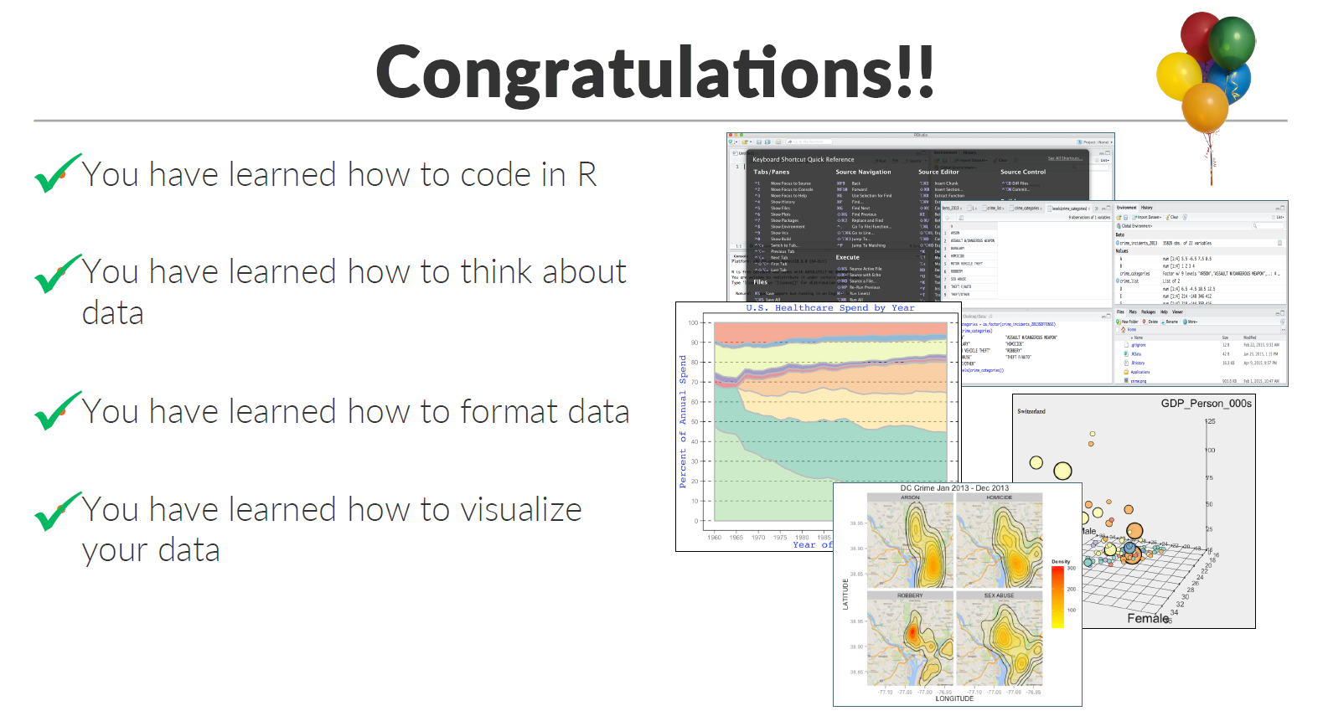

Slide 55
Resources
Help window or rdocumentation.org – provide R resources and help pages for all base R functions and packages.
Stack Overflow for questions and answers
R-bloggers, r4stats, r-statistics for R news and tutorials
Data visualization - flowingdata.com
Free online courses: DataCamp, EdX
Fox, J. (2005). R commander: A basic-statistics user interface to R. Journal of Statistical Software. 14, (9), 1-42.
Teetor, P. (2011). 25 Recipes for Getting Started with R. Sebastopol, CA: O’Reilly Media Inc.
Teetor, P. (2011). R cookbook. Sebastopol, CA: O’Reilly Media Inc.
Crowley, M. J. (2007). The R Book. Chichester, New England: John Wiley & Sons, Ltd.
A Google search will provide millions of sites for addition R resources.

